Slide 1
POS tagging continued
21 February 2018

Slide 2
What is the probability of “vladimir”?
w2
 | vladimir | putin | was | welcomed | by | governments
vladimir | 0 | 42 | 0 | 0 | 0 | 0
putin | 0 | 0 | 8 | 0 | 1 | 0
was | 0 | 0 | 0 | 1 | 0 | 0
welcomed | 0 | 0 | 0 | 0 | 1 | 0
by | 1 | 0 | 0 | 0 | 0 | 1
governments | 0 | 0 | 0 | 0 | 0 | 0
# types = 8,425
# tokens = 72,459
# bigrams = 72, 341
# unique bigrams = 42,541
w1
vladimir | putin | was | welcomed | by | governments
52 | 290 | 319 | 4 | 472 | 13

Slide 3
What is P(welcomed|was)?
w2
 | vladimir | putin | was | welcomed | by | governments
vladimir | 0 | 42 | 0 | 0 | 0 | 0
putin | 0 | 0 | 8 | 0 | 1 | 0
was | 0 | 0 | 0 | 1 | 0 | 0
welcomed | 0 | 0 | 0 | 0 | 1 | 0
by | 1 | 0 | 0 | 0 | 0 | 1
governments | 0 | 0 | 0 | 0 | 0 | 0
# types = 8,425
# tokens = 72,459
# bigrams = 72, 341
# unique bigrams = 42,541
w1
vladimir | putin | was | welcomed | by | governments
52 | 290 | 319 | 4 | 472 | 13

Slide 4
What is the Markov Assumption?

Slide 5
What is the Chain Rule?

Slide 7

$${\hat{t}}_{1}^{n}= {argmax}_{t_{1}^{n}} P(t_{1}^{n}|w_{1}^{n})$$

Slide 8

$${\hat{t}}_{1}^{n}= {argmax}_{t_{1}^{n}} P(t_{1}^{n}|w_{1}^{n})$$
$${\hat{t}}_{1}^{n}={argmax}_{t_{1}^{n}} \frac{P\left(w_{1}^{n} | t_{1}^{n}\right) ∗P(t_{1}^{n})}{P(w_{1}^{n})}$$
?

Slide 9

$${\hat{t}}_{1}^{n}= {argmax}_{t_{1}^{n}} P(t_{1}^{n}|w_{1}^{n})$$
$${\hat{t}}_{1}^{n}={argmax}_{t_{1}^{n}} \frac{P\left(w_{1}^{n} | t_{1}^{n}\right) ∗P(t_{1}^{n})}{P(w_{1}^{n})}$$
$${\hat{t}}_{1}^{n}={argmax}_{t_{1}^{n}} P\left(w_{1}^{n} | t_{1}^{n}\right) ∗P(t_{1}^{n})$$
Bayes Rule
?

Slide 10

$${\hat{t}}_{1}^{n}= {argmax}_{t_{1}^{n}} P(t_{1}^{n}|w_{1}^{n})$$
$${\hat{t}}_{1}^{n}={argmax}_{t_{1}^{n}} \frac{P\left(w_{1}^{n} | t_{1}^{n}\right) ∗P(t_{1}^{n})}{P(w_{1}^{n})}$$
$${\hat{t}}_{1}^{n}={argmax}_{t_{1}^{n}} P\left(w_{1}^{n} | t_{1}^{n}\right) ∗P(t_{1}^{n})$$
$${\hat{t}}_{1}^{n}≈ {argmax}_{t_{1}^{n}}\prod_{i=1}^{n}{P(w_{i}|t_{i})}∗P(t_{1}^{n})$$
Bayes Rule
Removed denominaVBr
because same over all
calculations – doesn’t
change the outcome
?

Slide 11
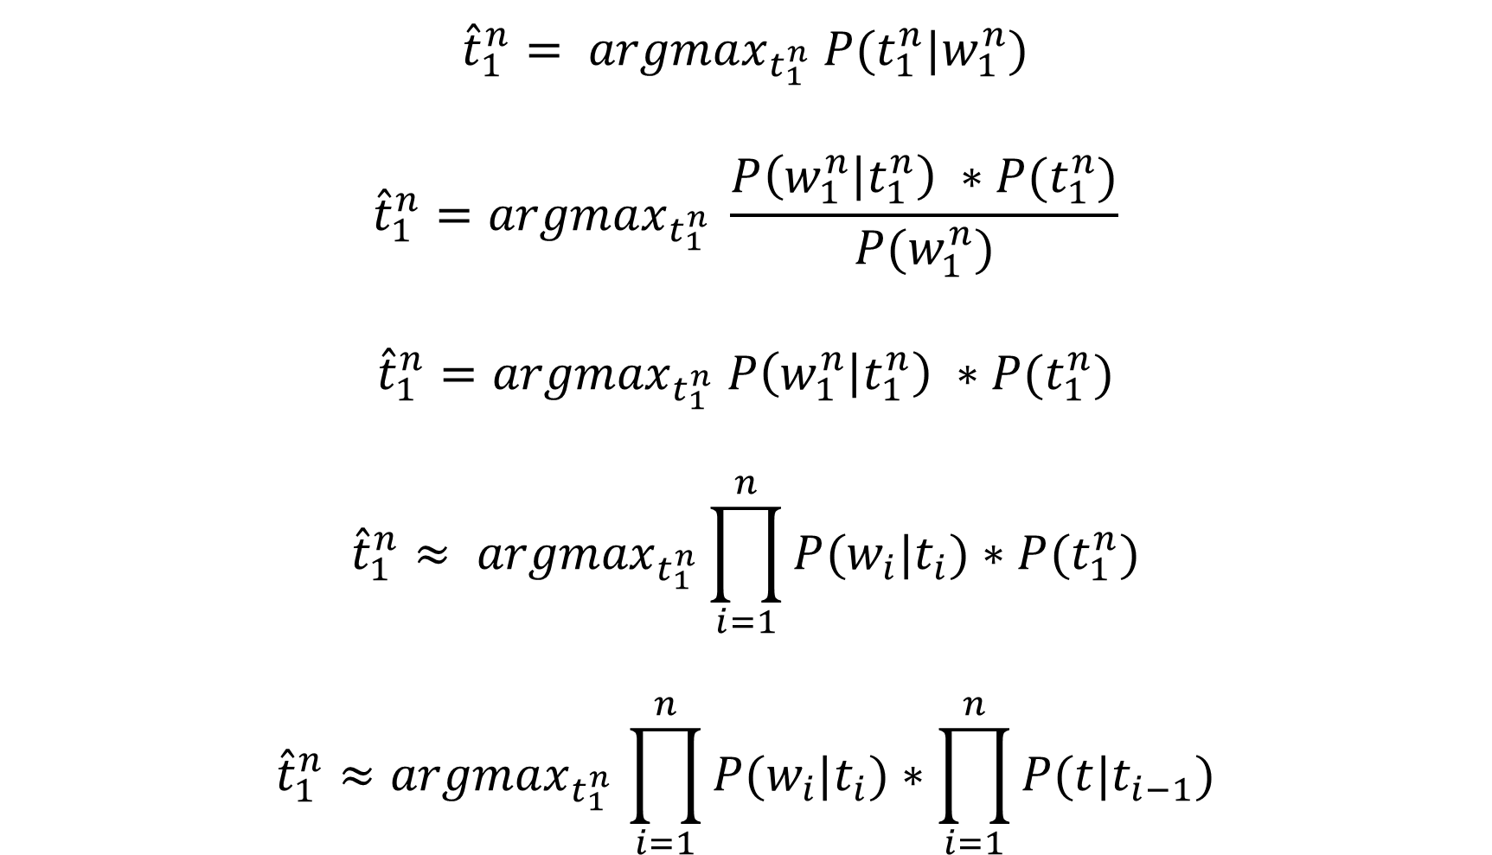
$${\hat{t}}_{1}^{n}= {argmax}_{t_{1}^{n}} P(t_{1}^{n}|w_{1}^{n})$$
$${\hat{t}}_{1}^{n}={argmax}_{t_{1}^{n}} \frac{P\left(w_{1}^{n} | t_{1}^{n}\right) ∗P(t_{1}^{n})}{P(w_{1}^{n})}$$
$${\hat{t}}_{1}^{n}={argmax}_{t_{1}^{n}} P\left(w_{1}^{n} | t_{1}^{n}\right) ∗P(t_{1}^{n})$$
$${\hat{t}}_{1}^{n}≈ {argmax}_{t_{1}^{n}}\prod_{i=1}^{n}{P(w_{i}|t_{i})}∗P(t_{1}^{n})$$
$${\hat{t}}_{1}^{n}{≈argmax}_{t_{1}^{n}}\prod_{i=1}^{n}{P(w_{i}|t_{i})}∗\prod_{i=1}^{n}{P(t|t_{i−1})}$$
Bayes Rule
Removed denominator
because same over all
calculations – doesn’t
change the outcome
Assumption 1:
words are independent
of their tags
?

Slide 12
$${\hat{t}}_{1}^{n}= {argmax}_{t_{1}^{n}} P(t_{1}^{n}|w_{1}^{n})$$
$${\hat{t}}_{1}^{n}={argmax}_{t_{1}^{n}} \frac{P\left(w_{1}^{n} | t_{1}^{n}\right) ∗P(t_{1}^{n})}{P(w_{1}^{n})}$$
$${\hat{t}}_{1}^{n}={argmax}_{t_{1}^{n}} P\left(w_{1}^{n} | t_{1}^{n}\right) ∗P(t_{1}^{n})$$
$${\hat{t}}_{1}^{n}≈ {argmax}_{t_{1}^{n}}\prod_{i=1}^{n}{P(w_{i}|t_{i})}∗P(t_{1}^{n})$$
$${\hat{t}}_{1}^{n}{≈argmax}_{t_{1}^{n}}\prod_{i=1}^{n}{P(w_{i}|t_{i})}∗\prod_{i=1}^{n}{P(t|t_{i−1})}$$
Bayes Rule
Removed denominaVBr
because same over all
calculations – doesn’t
change the outcome
Assumption 1:
words are independent
of their tags
Assumption 2:
Markov assumption
Bigram Model

Slide 13

$${\hat{t}}_{1}^{n}{≈argmax}_{t_{1}^{n}}\prod_{i=1}^{n}{P(w_{i}|t_{i})}∗\prod_{i=1}^{n}{P(t|t_{i−1})}$$
$${\hat{t}}_{1}^{n}{≈argmax}_{t_{1}^{n}}\prod_{i=1}^{n}{P(w_{i}|t_{i})}∗P(t_{i}|t_{i−1})$$

Slide 14

Example
I shot the elephant in my pajamas
I/(PRP|NNS) shot/(VBD|VB) the/DT elephant/NN in/IN my/PRP pajamas/NNS
$$\hat{t}=argmax(\prod_{i}^{n}{P\left(w_{i} | t_{i}\right) ∗P(t_{i}|t_{i−1})}$$

Slide 15

I/(PRP|NNS) shot/(VBD|VB) the/DT elephant/NN in/IN my/PRP pajamas/NNS
$$\hat{t}=argmax(\prod_{i}^{n}{P\left(w_{i} | t_{i}\right) ∗P(t_{i}|t_{i−1})}$$

Slide 16

I/(PRP|NNS) shot/(VBD|VB) the/DT elephant/NN in/IN my/PRP pajamas/NNS
$$\hat{t}=argmax($$
$$P\left(I | PRP\right)∗P\left(PRP | <start>\right)∗$$

Slide 17

I/(PRP|NNS) shot/(VBD|VB) the/DT elephant/NN in/IN my/PRP pajamas/NNS
$$\hat{t}=argmax($$
$$P\left(I | PRP\right)∗P\left(PRP | <start>\right)∗$$
$$P\left(shot | VBD\right)∗P\left(VBD | PRP\right)∗$$

Slide 18

I/(PRP|NNS) shot/(VBD|VB) the/DT elephant/NN in/IN my/PRP pajamas/NNS
$$\hat{t}=argmax($$
$$P\left(I | PRP\right)∗P\left(PRP | <start>\right)∗$$
$$P\left(shot | VBD\right)∗P\left(VBD | PRP\right)∗$$
$$P\left(the | DT\right)∗P\left(DT | VBD\right)∗$$

Slide 19

I/(PRP|NNS) shot/(VBD|VB) the/DT elephant/NN in/IN my/PRP pajamas/NNS
$$\hat{t}=argmax($$
$$P\left(I | PRP\right)∗P\left(PRP | <start>\right)∗$$
$$P\left(shot | VBD\right)∗P\left(VBD | PRP\right)∗$$
$$P\left(the | DT\right)∗P\left(DT | VBD\right)∗$$
$$P\left(elephant | NN\right)∗P\left(NN | DT\right)∗$$

Slide 20

I/(PRP|NNS) shot/(VBD|VB) the/DT elephant/NN in/IN my/PRP pajamas/NNS
$$\hat{t}=argmax($$
$$P\left(I | PRP\right)∗P\left(PRP | <start>\right)∗$$
$$P\left(shot | VBD\right)∗P\left(VBD | PRP\right)∗$$
$$P\left(the | DT\right)∗P\left(DT | VBD\right)∗$$
$$P\left(elephant | NN\right)∗P\left(NN | DT\right)∗$$
$$P\left(in | IN\right)∗P\left(IN | NN\right)∗$$

Slide 21

I/(PRP|NNS) shot/(VBD|VB) the/DT elephant/NN in/IN my/PRP pajamas/NNS
$$\hat{t}=argmax($$
$$P\left(I | PRP\right)∗P\left(PRP | <start>\right)∗$$
$$P\left(shot | VBD\right)∗P\left(VBD | PRP\right)∗$$
$$P\left(the | DT\right)∗P\left(DT | VBD\right)∗$$
$$P\left(elephant | NN\right)∗P\left(NN | DT\right)∗$$
$$P\left(in | IN\right)∗P\left(IN | NN\right)∗$$
$$P\left(my | PRP\right)∗P\left(PRP | IN\right)∗$$

Slide 22

I/(PRP|NNS) shot/(VBD|VB) the/DT elephant/NN in/IN my/PRP pajamas/NNS
$$\hat{t}=argmax($$
$$P\left(I | PRP\right)∗P\left(PRP | <start>\right)∗$$
$$P\left(shot | VBD\right)∗P\left(VBD | PRP\right)∗$$
$$P\left(the | DT\right)∗P\left(DT | VBD\right)∗$$
$$P\left(elephant | NN\right)∗P\left(NN | DT\right)∗$$
$$P\left(in | IN\right)∗P\left(IN | NN\right)∗$$
$$P\left(my | PRP\right)∗P\left(PRP | IN\right)∗$$
$$P\left(pajamas | NNS\right)∗P(NNS|PRP)$$
) = ?

Slide 23
I/(PRP|NNS) shot/(VBD|VB) the/DT elephant/NN in/IN my/PRP pajamas/NNS
$$\hat{t}=argmax(\prod_{i}^{n}{P\left(w_{i} | t_{i}\right) ∗P(t_{i}|t_{i−1})}$$

Slide 24
I/(PRP|NNS) shot/(VBD|VB) the/DT elephant/NN in/IN my/PRP pajamas/NNS
$$\hat{t}=argmax($$
$$P\left(I | PRP\right)∗P\left(PRP | <start>\right)∗$$

Slide 25

I/(PRP|NNS) shot/(VBD|VB) the/DT elephant/NN in/IN my/PRP pajamas/NNS
$$\hat{t}=argmax($$
$$P\left(I | PRP\right)∗P\left(PRP | <start>\right)∗$$
$$P\left(shot | VB\right)∗P\left(VB | PRP\right)∗$$

Slide 26

I/(PRP|NNS) shot/(VBD|VB) the/DT elephant/NN in/IN my/PRP pajamas/NNS
$$\hat{t}=argmax($$
$$P\left(I | PRP\right)∗P\left(PRP | <start>\right)∗$$
$$P\left(shot | VB\right)∗P\left(VB | PRP\right)∗$$
$$P\left(the | DT\right)∗P\left(DT | VB\right)∗$$

Slide 27

I/(PRP|NNS) shot/(VBD|VB) the/DT elephant/NN in/IN my/PRP pajamas/NNS
$$\hat{t}=argmax($$
$$P\left(I | PRP\right)∗P\left(PRP | <start>\right)∗$$
$$P\left(shot | VB\right)∗P\left(VB | PRP\right)∗$$
$$P\left(the | DT\right)∗P\left(DT | VB\right)∗$$
$$P\left(elephant | NN\right)∗P\left(NN | DT\right)∗$$

Slide 28

I/(PRP|NNS) shot/(VBD|VB) the/DT elephant/NN in/IN my/PRP pajamas/NNS
$$\hat{t}=argmax($$
$$P\left(I | PRP\right)∗P\left(PRP | <start>\right)∗$$
$$P\left(shot | VB\right)∗P\left(VB | PRP\right)∗$$
$$P\left(the | DT\right)∗P\left(DT | VB\right)∗$$
$$P\left(elephant | NN\right)∗P\left(NN | DT\right)∗$$
$$P\left(in | IN\right)∗P\left(IN | NN\right)∗$$

Slide 29

I/(PRP|NNS) shot/(VBD|VB) the/DT elephant/NN in/IN my/PRP pajamas/NNS
$$\hat{t}=argmax($$
$$P\left(I | PRP\right)∗P\left(PRP | <start>\right)∗$$
$$P\left(shot | VB\right)∗P\left(VB | PRP\right)∗$$
$$P\left(the | DT\right)∗P\left(DT | VB\right)∗$$
$$P\left(elephant | NN\right)∗P\left(NN | DT\right)∗$$
$$P\left(in | IN\right)∗P\left(IN | NN\right)∗$$
$$P\left(my | PRP\right)∗P\left(PRP | IN\right)∗$$

Slide 30

I/(PRP|NNS) shot/(VBD|VB) the/DT elephant/NN in/IN my/PRP pajamas/NNS
$$\hat{t}=argmax($$
$$P\left(I | PRP\right)∗P\left(PRP | <start>\right)∗$$
$$P\left(shot | VB\right)∗P\left(VB | PRP\right)∗$$
$$P\left(the | DT\right)∗P\left(DT | VB\right)∗$$
$$P\left(elephant | NN\right)∗P\left(NN | DT\right)∗$$
$$P\left(in | IN\right)∗P\left(IN | NN\right)∗$$
$$P\left(my | PRP\right)∗P\left(PRP | IN\right)∗$$
$$P\left(pajamas | NNS\right)∗P(NNS|PRP)$$
) = ?

Slide 31
I/(PRP|NNS) shot/(VBD|VB) the/DT elephant/NN in/IN my/PRP pajamas/NNS
$$\hat{t}=argmax(\prod_{i}^{n}{P\left(w_{i} | t_{i}\right) ∗P(t_{i}|t_{i−1})}$$

Slide 32

I/(PRP|NNS) shot/(VBD|VB) the/DT elephant/NN in/IN my/PRP pajamas/NNS
$$\hat{t}=argmax($$
$$P\left(I | NNS\right)∗P\left(NNS | <start>\right)∗$$

Slide 33

I/(PRP|NNS) shot/(VBD|VB) the/DT elephant/NN in/IN my/PRP pajamas/NNS
$$\hat{t}=argmax($$
$$P\left(I | NNS\right)∗P\left(NNS | <start>\right)∗$$
$$P\left(shot | VBD\right)∗P\left(VBD | NNS\right)∗$$

Slide 34

I/(PRP|NNS) shot/(VBD|VB) the/DT elephant/NN in/IN my/PRP pajamas/NNS
$$\hat{t}=argmax($$
$$P\left(I | NNS\right)∗P\left(NNS | <start>\right)∗$$
$$P\left(shot | VBD\right)∗P\left(VBD | NNS\right)∗$$
$$P\left(the | DT\right)∗P\left(DT | VBD\right)∗$$

Slide 35

I/(PRP|NNS) shot/(VBD|VB) the/DT elephant/NN in/IN my/PRP pajamas/NNS
$$\hat{t}=argmax($$
$$P\left(I | NNS\right)∗P\left(NNS | <start>\right)∗$$
$$P\left(shot | VBD\right)∗P\left(VBD | NNS\right)∗$$
$$P\left(the | DT\right)∗P\left(DT | VBD\right)∗$$
$$P\left(elephant | NN\right)∗P\left(NN | DT\right)∗$$

Slide 36

I/(PRP|NNS) shot/(VBD|VB) the/DT elephant/NN in/IN my/PRP pajamas/NNS
$$\hat{t}=argmax($$
$$P\left(I | NNS\right)∗P\left(NNS | <start>\right)∗$$
$$P\left(shot | VBD\right)∗P\left(VBD | NNS\right)∗$$
$$P\left(the | DT\right)∗P\left(DT | VBD\right)∗$$
$$P\left(elephant | NN\right)∗P\left(NN | DT\right)∗$$
$$P\left(in | IN\right)∗P\left(IN | NN\right)∗$$

Slide 37

I/(PRP|NNS) shot/(VBD|VB) the/DT elephant/NN in/IN my/PRP pajamas/NNS
$$\hat{t}=argmax($$
$$P\left(I | NNS\right)∗P\left(NNS | <start>\right)∗$$
$$P\left(shot | VBD\right)∗P\left(VBD | NNS\right)∗$$
$$P\left(the | DT\right)∗P\left(DT | VBD\right)∗$$
$$P\left(elephant | NN\right)∗P\left(NN | DT\right)∗$$
$$P\left(in | IN\right)∗P\left(IN | NN\right)∗$$
$$P\left(my | PRP\right)∗P\left(PRP | IN\right)∗$$

Slide 38

I/(PRP|NNS) shot/(VBD|VB) the/DT elephant/NN in/IN my/PRP pajamas/NNS
$$\hat{t}=argmax($$
$$P\left(I | NNS\right)∗P\left(NNS | <start>\right)∗$$
$$P\left(shot | VBD\right)∗P\left(VBD | NNS\right)∗$$
$$P\left(the | DT\right)∗P\left(DT | VBD\right)∗$$
$$P\left(elephant | NN\right)∗P\left(NN | DT\right)∗$$
$$P\left(in | IN\right)∗P\left(IN | NN\right)∗$$
$$P\left(my | PRP\right)∗P\left(PRP | IN\right)∗$$
$$P\left(pajamas | NNS\right)∗P(NNS|PRP)$$
) = ?

Slide 39
I/(PRP|NNS) shot/(VBD|VB) the/DT elephant/NN in/IN my/PRP pajamas/NNS
$$\hat{t}=argmax(\prod_{i}^{n}{P\left(w_{i} | t_{i}\right) ∗P(t_{i}|t_{i−1})}$$

Slide 40
I/(PRP|NNS) shot/(VBD|VB) the/DT elephant/NN in/IN my/PRP pajamas/NNS
$$\hat{t}=argmax($$
$$P\left(I | NNS\right)∗P\left(NNS | <start>\right)∗$$

Slide 41

I/(PRP|NNS) shot/(VBD|VB) the/DT elephant/NN in/IN my/PRP pajamas/NNS
$$\hat{t}=argmax($$
$$P\left(I | NNS\right)∗P\left(NNS | <start>\right)∗$$
$$P\left(shot | VB\right)∗P\left(VB | NNS\right)∗$$

Slide 42

I/(PRP|NNS) shot/(VBD|VB) the/DT elephant/NN in/IN my/PRP pajamas/NNS
$$\hat{t}=argmax($$
$$P\left(I | NNS\right)∗P\left(NNS | <start>\right)∗$$
$$P\left(shot | VB\right)∗P\left(VB | NNS\right)∗$$
$$P\left(the | DT\right)∗P\left(DT | VB\right)∗$$

Slide 43

I/(PRP|NNS) shot/(VBD|VB) the/DT elephant/NN in/IN my/PRP pajamas/NNS
$$\hat{t}=argmax($$
$$P\left(I | NNS\right)∗P\left(NNS | <start>\right)∗$$
$$P\left(shot | VB\right)∗P\left(VB | NNS\right)∗$$
$$P\left(the | DT\right)∗P\left(DT | VB\right)∗$$
$$P\left(elephant | NN\right)∗P\left(NN | DT\right)∗$$

Slide 44

I/(PRP|NNS) shot/(VBD|VB) the/DT elephant/NN in/IN my/PRP pajamas/NNS
$$\hat{t}=argmax($$
$$P\left(I | NNS\right)∗P\left(NNS | <start>\right)∗$$
$$P\left(shot | VB\right)∗P\left(VB | NNS\right)∗$$
$$P\left(the | DT\right)∗P\left(DT | VB\right)∗$$
$$P\left(elephant | NN\right)∗P\left(NN | DT\right)∗$$
$$P\left(in | IN\right)∗P\left(IN | NN\right)∗$$

Slide 45

I/(PRP|NNS) shot/(VBD|VB) the/DT elephant/NN in/IN my/PRP pajamas/NNS
$$\hat{t}=argmax($$
$$P\left(I | NNS\right)∗P\left(NNS | <start>\right)∗$$
$$P\left(shot | VB\right)∗P\left(VB | NNS\right)∗$$
$$P\left(the | DT\right)∗P\left(DT | VB\right)∗$$
$$P\left(elephant | NN\right)∗P\left(NN | DT\right)∗$$
$$P\left(in | IN\right)∗P\left(IN | NN\right)∗$$
$$P\left(my | PRP\right)∗P\left(PRP | IN\right)∗$$

Slide 46

I/(PRP|NNS) shot/(VBD|VB) the/DT elephant/NN in/IN my/PRP pajamas/NNS
$$\hat{t}=argmax($$
$$P\left(I | NNS\right)∗P\left(NNS | <start>\right)∗$$
$$P\left(shot | VB\right)∗P\left(VB | NNS\right)∗$$
$$P\left(the | DT\right)∗P\left(DT | VB\right)∗$$
$$P\left(elephant | NN\right)∗P\left(NN | DT\right)∗$$
$$P\left(in | IN\right)∗P\left(IN | NN\right)∗$$
$$P\left(my | PRP\right)∗P\left(PRP | IN\right)∗$$
$$P\left(pajamas | NNS\right)∗P(NNS|PRP)$$
) = ?

Slide 47

I/(PRP|NNS) shot/(VBD|VB) the/DT elephant/NN in/IN my/PRP pajamas/NNS
$$\hat{t}=argmax($$
$$P\left(I | NNS\right)∗P\left(NNS | <start>\right)∗$$
$$P\left(shot | VB\right)∗P\left(VB | NNS\right)∗$$
$$P\left(the | DT\right)∗P\left(DT | VB\right)∗$$
$$P\left(elephant | NN\right)∗P\left(NN | DT\right)∗$$
$$P\left(in | IN\right)∗P\left(IN | NN\right)∗$$
$$P\left(my | PRP\right)∗P\left(PRP | IN\right)∗$$
$$P\left(pajamas | NNS\right)∗P(NNS|PRP)$$
) = ?
Don’t change – why?

Slide 48
I/(PRP|NNS) shot/(VBD|VB) the/DT elephant/NN in/IN my/PRP pajamas/NNS
$$\hat{t}=argmax($$
$$P\left(I | NNS\right)∗P\left(NNS | <start>\right)∗$$
$$P\left(shot | VB\right)∗P\left(VB | NNS\right)∗$$
$$P\left(the | DT\right)∗P\left(DT | VB\right)∗$$
$$P\left(elephant | NN\right)∗P\left(NN | DT\right)∗$$
$$P\left(in | IN\right)∗P\left(IN | NN\right)∗$$
$$P\left(my | PRP\right)∗P\left(PRP | IN\right)∗$$
$$P\left(pajamas | NNS\right)∗P(NNS|PRP)$$
) = ?
Changes – even though it only
has one possible POS tag – why?

Slide 49

$$P\left(w_{i} | t_{i}\right)= \frac{frequency(w_{i}, t_{i})}{frequency (t_{i})}$$
$$P\left(I | PRP\right)= \frac{frequency(I, PRP)}{frequency (PRP)}$$

Slide 50
$$P\left(w_{i} | t_{i}\right)= \frac{frequency(w_{i}, t_{i})}{frequency (t_{i})}$$
$$P\left(I | PRP\right)= \frac{frequency(I, PRP)}{frequency (PRP)}$$

Slide 51

$$P\left(t_{i} | t_{i−1}\right)= \frac{frequency(t_{i−1}, t_{i})}{frequency (t_{i−1})}$$
$$P\left(VB | PRP\right)= \frac{frequency(PRP VB)}{frequency (PRP)}$$

Slide 52
Where does this frequency information come from?

Slide 53
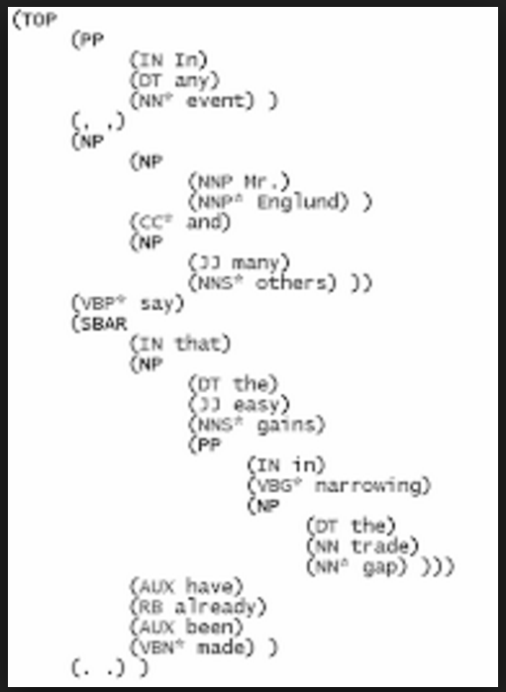
Where does this frequency information come from?
Data set that contains sentences where the words have been annotated with their POS
E.g. Penn Treebank

Slide 54
in was seen as a IN – 2 times
the was seen as a DT – 2 times
….
IN, DT was seen – 2 times
DT, NN was seen – 2 times
DT, JJ was seen – 1 times
…

Slide 55
Any questions?

Slide 56
Are you sure?

Slide 57
Given the sentence partially tagged sentence: Rand/NNP Paul/NNP is/VB running/? for/PRP President/NNP. Where running can be either a VB (verb) or a JJ (adjective) What is the probability of running being a verb? and What is the probability of running being an adjective?

Slide 58
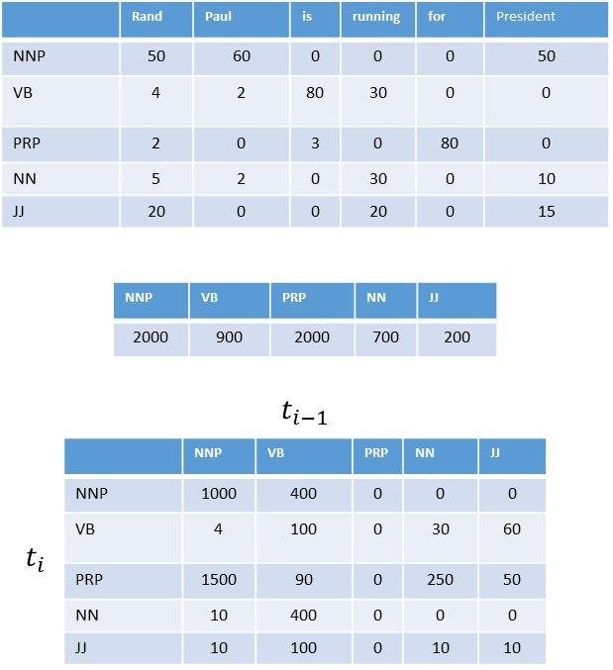
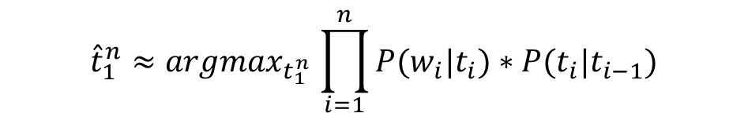
$${\hat{t}}_{1}^{n}{≈argmax}_{t_{1}^{n}}\prod_{i=1}^{n}{P(w_{i}|t_{i})}∗P(t_{i}|t_{i−1})$$
Given the sentence partially tagged sentence: Rand/NNP Paul/NNP is/VB running/? for/PRP President/NNP. Where running can be either a VB (verb) or a JJ (adjective).

Slide 59
Evaluation Methodology
Test set
Development/Test set
10 Fold Cross Validation

Slide 60
Evaluation
CORPUS
TEST
TRAIN
POS TAGGER
ACCURACY

Slide 61
Evaluation: 80-20
CORPUS
TEST
20%
80%
TRAIN
POS TAGGER
ACCURACY

Slide 62
TEST
CORPUS
DEVELOP-
MENT
SET
20%
20%
Develop Model
With Development
Set
60%
TRAIN
POS TAGGER
ACCURACY

Slide 63
CORPUS
TEST
20%
Evaluate Model
With Test
Set
60%
DEVELOP-
MENT
SET
TRAIN
POS TAGGER
ACCURACY

Slide 64
10 Fold Cross Validatation
SET 1
SET 2
CORPUS
TRAIN
SET 3
TRAIN
POS TAGGER
SET 4
…
SET 10
TEST

Slide 65
10 Fold Cross Validatation
SET 1
TEST
SET 2
POS TAGGER
CORPUS
TRAIN
SET 3
SET 4
TRAIN
…
SET 10

Slide 66
Cycle Through
Each file is used as a test once and only once
With the remaining used as train
Accuracy
Set 1
Accuracy
Set 2
Accuracy
Set 3
Accuracy
Set 4
Accuracy
Set 5
Accuracy
Set 6
Accuracy
Set 7
Accuracy
Set 8
Accuracy
Set 9
Accuracy
Set 10
AVERAGE ACCURACY

Slide 67
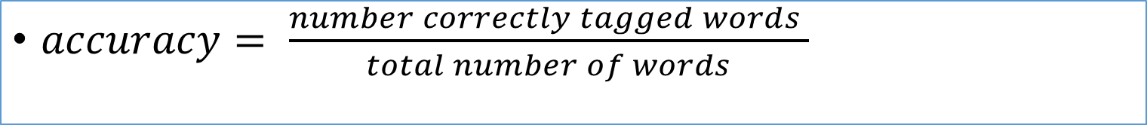
Accuracy
statistical measure of how well
The classification went
$accuracy= \frac{number correctly tagged words }{total number of words}$

Slide 68
How good is your algorithm?
Gold standard
Human labeled gold standard
Baseline comparison
Most frequent class baseline: assign each token to the most frequent class in the training set – in this case the most frequent POS

Slide 69
Error Analysis
PREDICTED CLASSES
 | VB | TO | NN
VB
TO
NN
Confusion matrix:
E.g. which tags did we most often confuse with which other tags?
How much of the overall error does each confusion account for?
ACTUAL CLASSES

Slide 70
Error Analysis
PREDICTED CLASSES
 | VB | TO | NN
VB | 10 | 0 | 0
TO | 0 | 10 | 0
NN | 0 | 0 | 10
PERFECT CLASSIFIER would have zeros in all
cells except for the diagnole
Simple example, with
ten instances of each
POS Tag
ACTUAL CLASSES

Slide 71
Error Analysis
PREDICTED CLASSES
 | VB | TO | NN
VB | 5 | 0 | 5
TO | 0 | 10 | 0
NN | 10 | 0 | 0
To generate rules:
take a look at the confusion matrix, see where things are going wrong and if there is a rule that you could incorporate to aid in fixing this
ACTUAL CLASSES

Slide 72
Questions?

